Slide 1
Transportation Guide and Resources 2024

Slide 2
Transportation
Transportation is important to all of us--it links individuals to social connections, religious activities, medical appointments, groceries, pharmacies, and much more.
Consider how you would maintain your connection to the community if you could not drive?
“According to the American Journal of Public Health, individuals on average can expect to live between 6 to 10 years retired from driving.”
Notes:
A comparison of the men’s and women’s driving life expectancies with total life expectancies found that subsequent to driving cessation, men will have about 6 years of dependency on alternative sources of transportation, compared with about 10 years of dependency for women. - https://www.ncbi.nlm.nih.gov/pmc/articles/PMC1447231/

Slide 3
Transportation
Transportation remains among the top unmet needs identified among older and disabled adults.
Goals for today’s presentation:
Raise awareness of this unmet need.
Increase familiarity of local transportation resources for ourselves and our loved ones.
Encourage individuals to develop transportation alternatives as part of their long-term aging plan.
Notes:
“In a 2018 national survey of older adults, people with disabilities and caregivers conducted by the NADTC, the survey reported that most of the respondents turned to family, friends or neighbors for information about transportation services available in the community.”

Slide 4
Transportation Guide
Designed to assist older adults and people with disabilities seeking transportation services.
Provided as a resource for professionals, older adults, and their caregivers.
Available online and in Spanish.
Newly Updated!
agencies with transportation needs.
Notes:
The Transportation Guide is a resource designed to aid both individuals and community service agencies, and is available in both hard copy and electronic version. The Guide provides definitions of the different types of transportation services, and lists contact information for the corresponding services agencies across the nine-county Centralina region as well as Lancaster and York Counties in South Carolina. In addition to helpful tips and considerations when using transportation services, the Guide also explains services such as Lyft and Uber and how to use them.

Slide 5
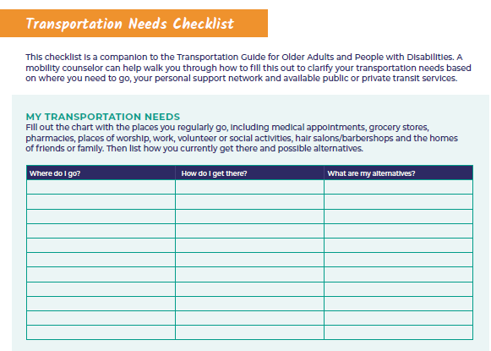
Notes:
The guide features a useful insert, the Transportation Needs Checklist, created to help the user clarify his/her personalized transportation needs. This checklist encourages individuals to review their existing transportation support network and explore what alternatives might be available should the need arise.

Slide 6
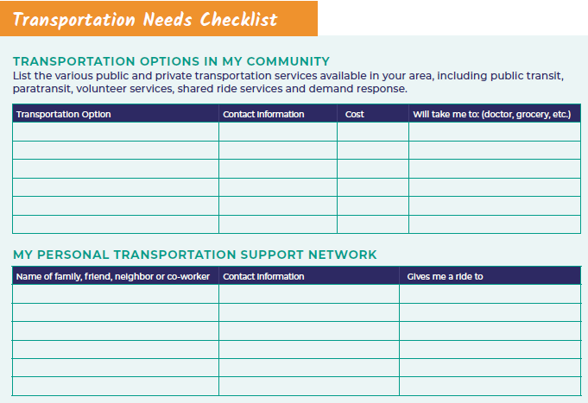
Notes:
Once you determine where you need to go, use this page to list the transportation options in your area, and to list the names and numbers of those in your own support network.

Slide 7
Key Considerations: Planning Your Trip
What is the cost of this service?
Are accessible vehicles available?
How long will I have to wait?
Can my caregiver ride with me?
What is your coverage area?
Notes:
The Guide also features a section called “Key Considerations” which helps the rider consider various important questions as they plan a trip. Users are encouraged to think about any special accommodations and ask providers questions to evaluate their choices.

Slide 8
Transportation Guide & Toolkit
Notes:
Centralina AAA has created an online resource toolkit that that offers something for everyone including service agency staff, older individuals who drive, and those who need transportation services. We’ve included a bit of transportation fun as well!

Slide 9
Ridesharing Information
What ridesharing is and how it works
How to book rides with Uber and Lyft
Scheduling through GoGoGrandparent and Lively
How to pay
Using a service animal, wheelchair, or other mobility device
How professionals can book rides for others.
Notes:
Centralina AAA has created an online resource toolkit that that offers something for everyone including service agency staff, older individuals who drive, and those who need transportation services. We’ve included a bit of transportation fun as well!

Slide 10
Updated Transportation Guide 2.0 features: Older Driver Safety
Older Driver Safety Agreement
Older Driver Planning Tool
Older Driver Resources
Notes:
Additional new information includes driver safety information and resources.

Slide 11
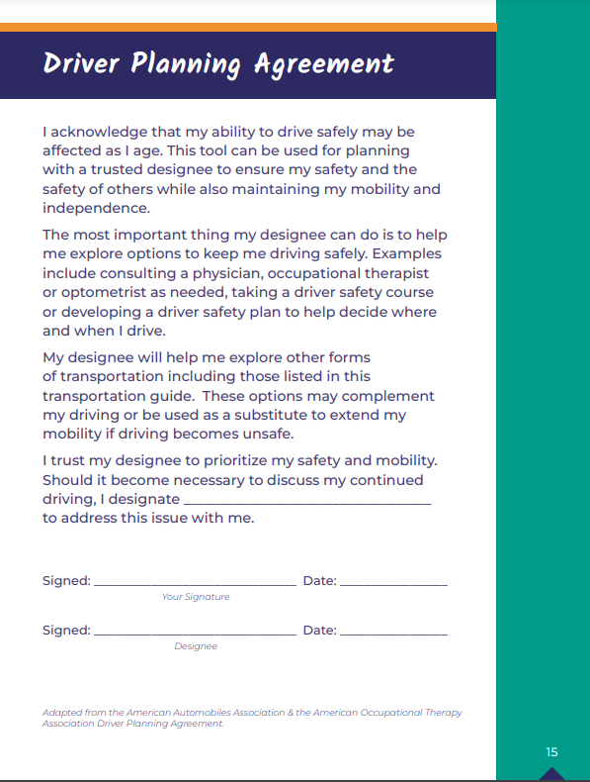
Driver Planning Agreement
Encourages drivers to plan and discuss alternate transportation options with loved ones before the need to retire from driving.
Acknowledges the driver may become unable to drive in the future.
Identifies a trusted designee to help address this challenging issue and explore other options.
Prioritizes safety and the importance of continued mobility.
-Agreement is adapted from the American Automobiles Association & the American Occupational Therapy Association Driver Planning Agreement
Notes:
We have added to the Driving Resources section – Guide now reviews the important, and sometimes difficult, decision regarding retiring from driving in cases where age-related changes can impact one’s ability to drive safely.
Just as we plan to identify future healthcare and care decisions, we can also develop an individual plan regarding how we want to approach the possibility of needing to retire from driving.

Slide 12
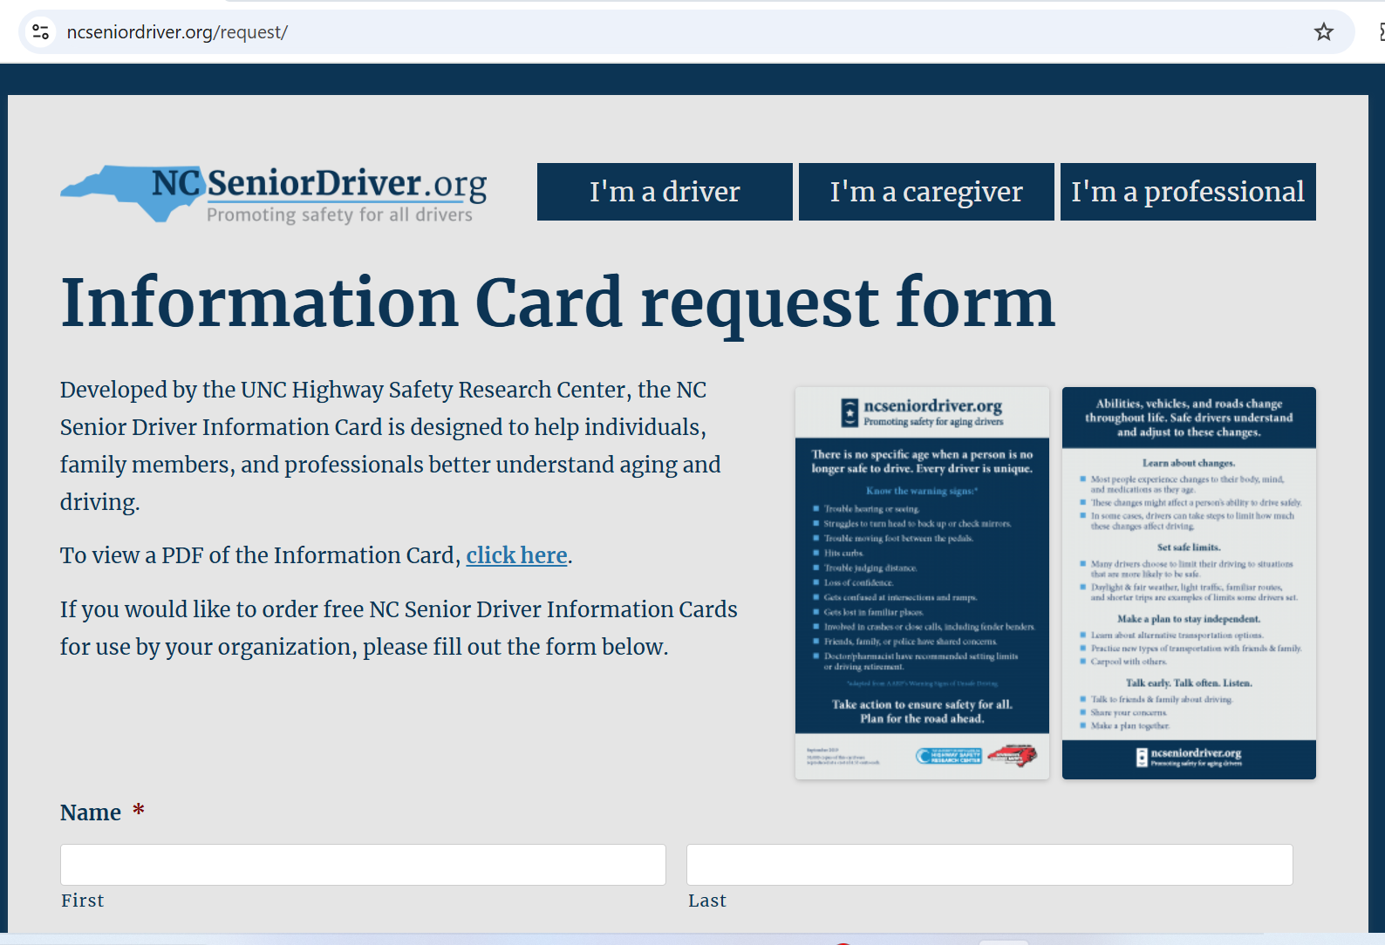
Older Driver Safety
https://www.ncseniordriver.org/request/
Notes:
You can order up to 20 packets of 100 cards (2,000 cards) at a time.
Visit https://www.ncseniordriver.org/request/

Slide 13
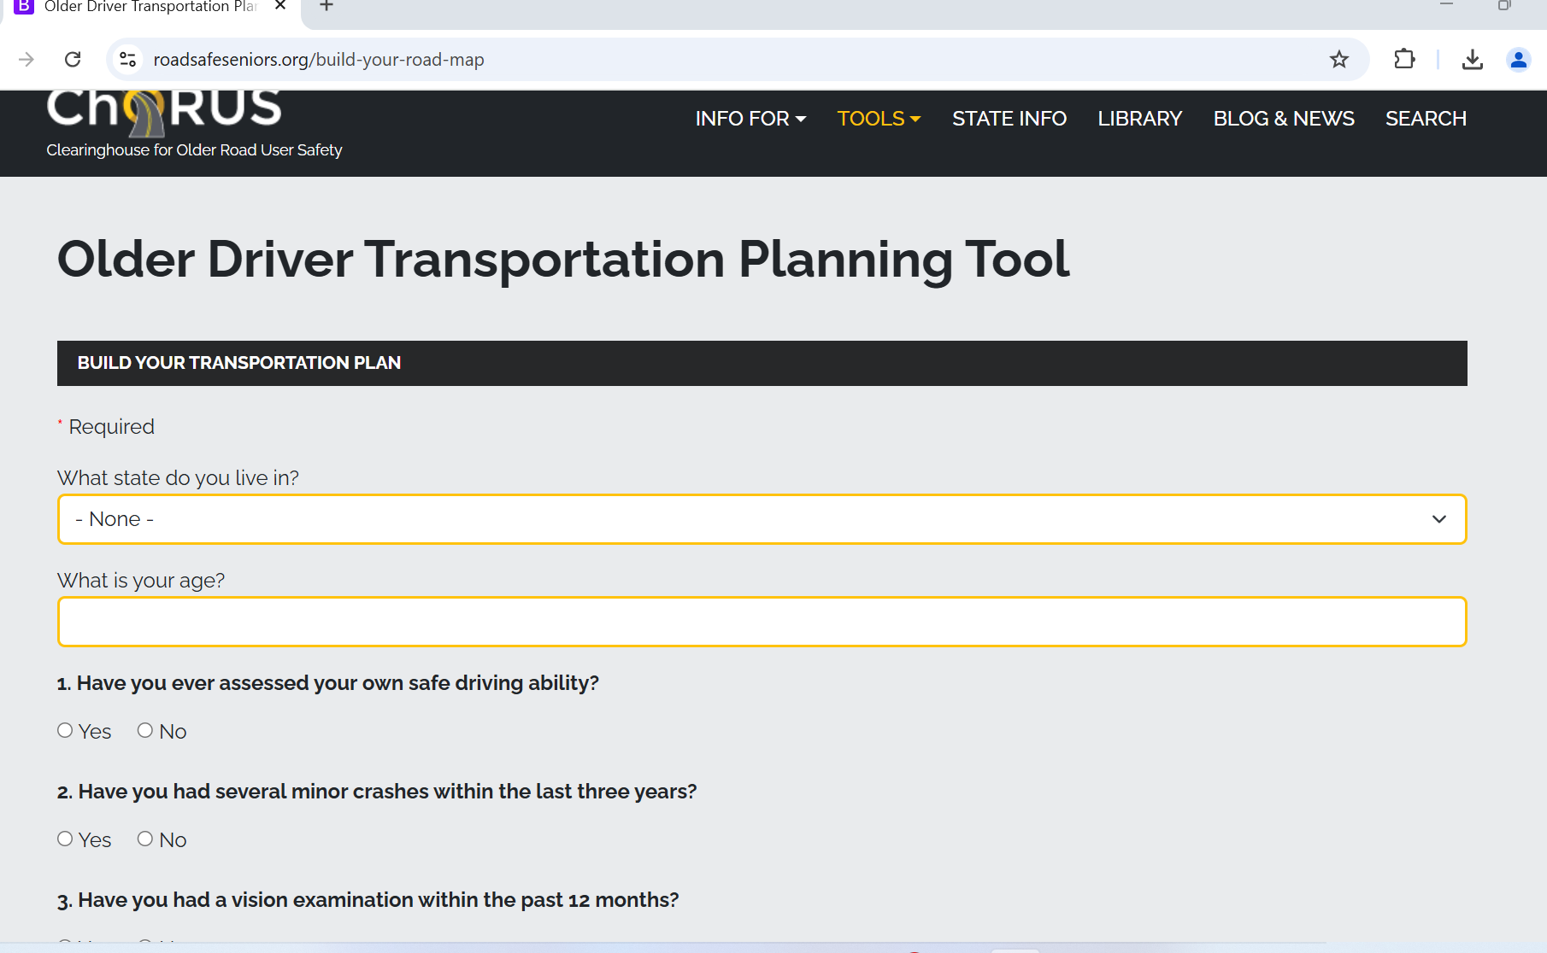
Older Driver Planning Tool
https://www.roadsafeseniors.org/build-your-road-map
Notes:
This took found on the CHORUS website includes 13 questions to develop a personalized transportation planning tool. This is an excellent resource!

Slide 14
Transportation Toolkit
In addition to the Transportation Guide, be sure to check out the Transportation Toolkit for additional resources, such as:
Driver Safety Resources
Accessible Transportation Information
Transportation Games & Fun
Notes:
Centralina AAA has created an online resource toolkit that that offers something for everyone including service agency staff, older individuals who drive, and those who need transportation services. We’ve included a bit of transportation fun as well!

Slide 15
Additional Training Resources
Notes:
Centralina AAA has created an online resource toolkit that that offers something for everyone including service agency staff, older individuals who drive, and those who need transportation services. We’ve included a bit of transportation fun as well!
Visit https://centralinaaging.org/what-we-do-services/transportation/ for more information

Slide 16
Transportation Training www.centralinaaging.org
Centralina AAA
Transportation Mini-Series
Short recordings about transportation considerations for older adults and people with disabilities.
Recorded and Upcoming Webinars
Beyond Driving with Dignity
Age-Friendly Communities: Walkability and Pedestrian Safety

Slide 17
For more information, contact:
Katie Kutcher - kkutcher@centralina.org or 704-348-2705
Laurie Abounader – labounader@centralina.org or 704-688-6501

Slide 18
THANK YOU
704-372-2416 | info@centralina.org | 10735 David Taylor Drive, Suite 250, Charlotte, NC 28262 | www.centralina.org

