Slide 1
Social Isolation and Loneliness Among Aging Adults
Notes:
AD

Slide 2
Dr. Vivek H. Murthy, U.S. Surgeon General
“The health and societal impacts of social isolation and loneliness are a critical public health concern.”
Notes:
https://www.hhs.gov/sites/default/files/surgeon-general-social-connection-advisory.pdf
AD

Slide 3
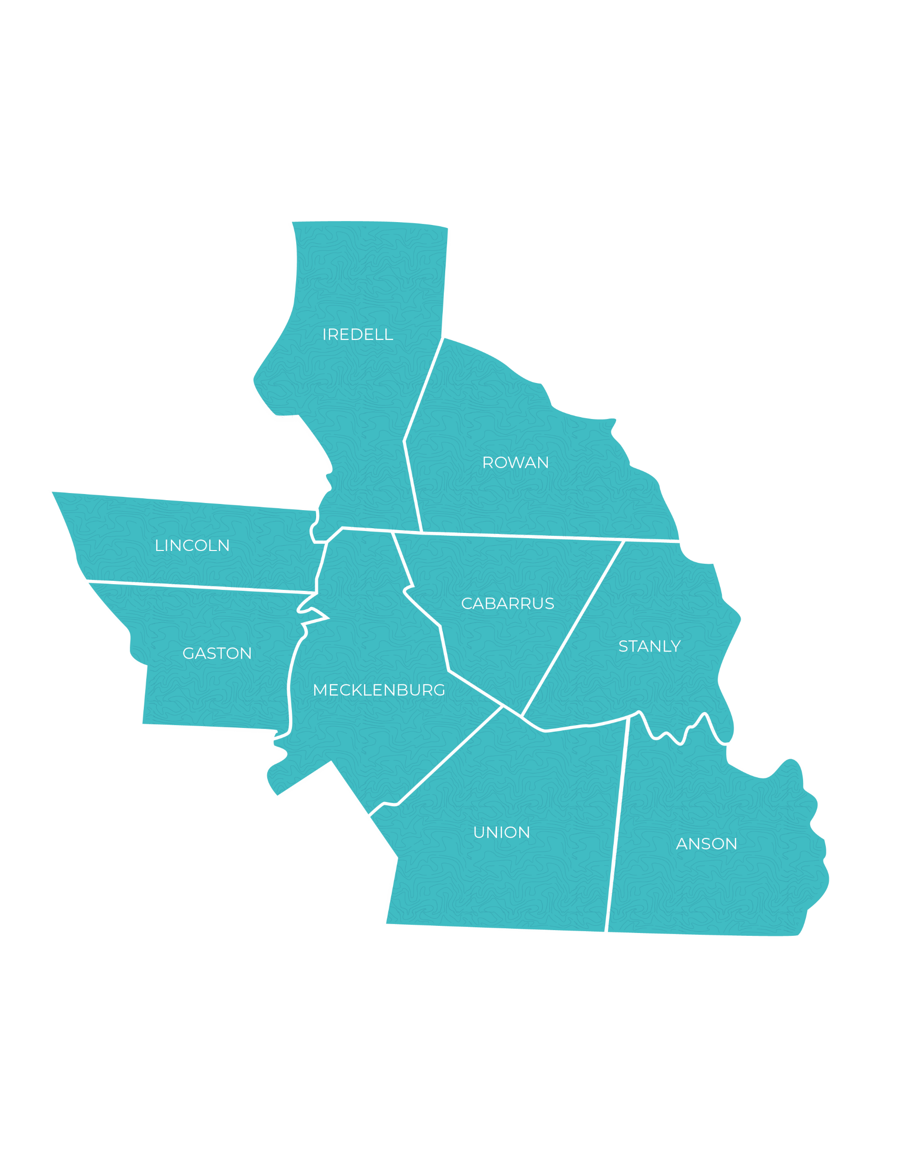
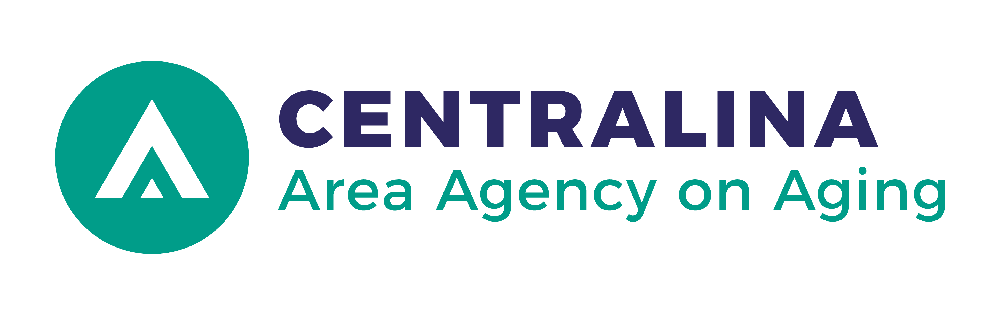

Our purposes are to plan, develop, coordinate and deliver a wide range of long-term senior services and supports to consumers in the region.
800.508.5777
wwww.CentralinaAging.org
Centralina Area Agency on Aging is a division of Centralina Regional Council, a nine-county member government organization based in Charlotte, N.C.
Notes:
AD

Slide 4


Slide 5
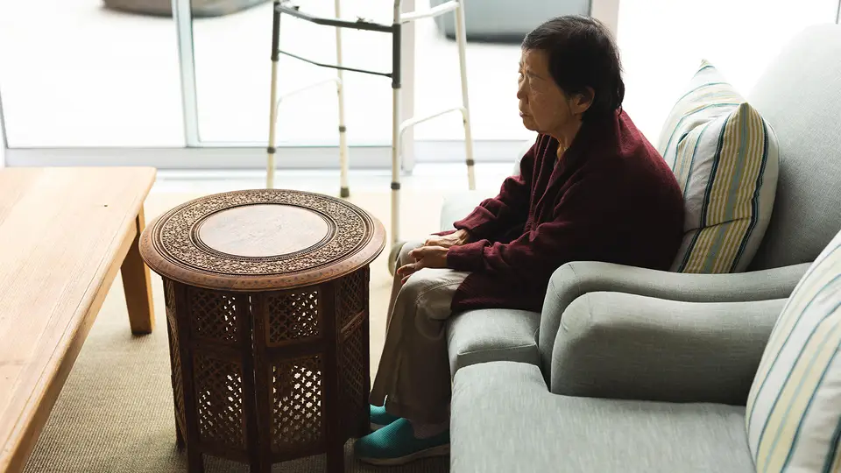
What is the difference between Social Isolation and Loneliness?
Social isolation is the lack of social connections and/or contacts and having few people to interact with regularly.
Loneliness is the distressing feeling of being alone or separated.
Notes:
Social isolation can lead to loneliness in some people, while others can feel lonely without being socially isolated.
AD

Slide 6
Target Population and Statistics
In North Carolina, 26.8% of people 65 and older live alone and are vulnerable to social isolation.
Of the socially isolated population, 21.4% of people aged 65 or older are part of a racial or ethnic minority population.
Notes:
KW

Slide 7
Groups at highest risk for social disconnection
Low-income adults
Young adults
Older adults
Adults living alone
People with chronic diseases and disabilities
Immigrants
Individuals who identify as lesbian, gay, bisexual, transgender, and questioning (or queer)
Notes:
KW

Slide 8
Risk factors
Live alone
Can’t leave your home
Had a major loss or life change, such as the death of a spouse or partner, or retirement
Struggle with money
Are a caregiver
Have psychological or cognitive challenges or depression
Have limited social support
Have trouble hearing
Live in a rural, unsafe and/or hard-to-reach neighborhood
Have language barriers where you live
Experience age, racial, ethnic, sexual orientation and/or gender identity discrimination where you live
Are not meaningfully engaged in activities or are feeling a lack of purpose
Notes:
KW

Slide 9
Health Impact
“Over four decades of research has produced robust evidence that lacking social connection and, in particular, scoring high on measures of social isolation, is associated with a significantly increased risk for early death from all causes”
-2020 Consensus Study Report
Notes:
KW

Slide 10
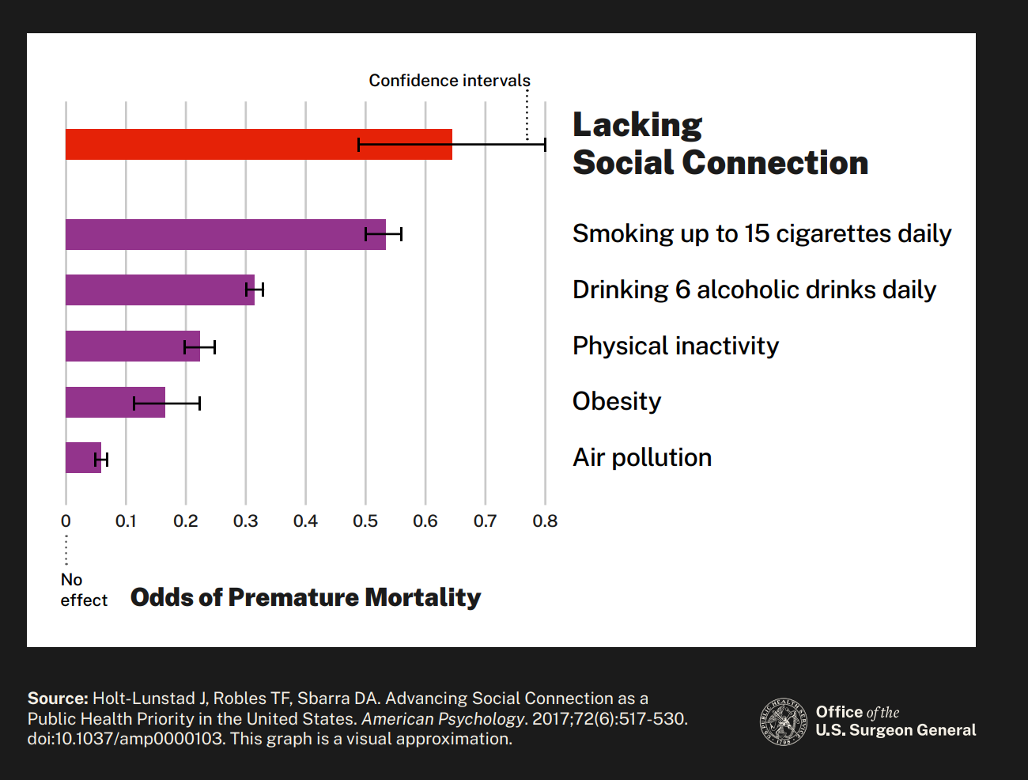
Health Impact
Notes:
Lacking social connection is as dangerous as smoking up to 15 cigarettes a day.
KW

Slide 11
Health Risks
High blood pressure
Heart disease
Obesity
Weakened immune function
Anxiety
Depression
Cognitive decline
Dementia, including Alzheimer’s disease
Premature death
Notes:
AD

Slide 12

Health Risks
Loneliness among heart failure patients was associated with a nearly:
  Four times increased risk of death
  68% increased risk of hospitalization
  57% increased risk of emergency department visits
Notes:
Although it’s hard to measure social isolation and loneliness precisely, there is strong evidence that many adults aged 50 and older are socially isolated or lonely in ways that put their health at risk.
AD

Slide 13
Socially Connected Communities
Decades of research across disciplines show that higher levels of social connectedness suggest better community outcomes, ranging from population health to community safety, resilience, prosperity and representative government.
These studies establish that social connection is vital not only to our physical, mental and emotional health, but also to the health and well-being of our communities
Page 36- Our Epidemic of Loneliness and Isolation: The U.S. Surgeon General’s Advisory on the Healing Effects of Social Connection and Community. 2023
Notes:
AD

Slide 14
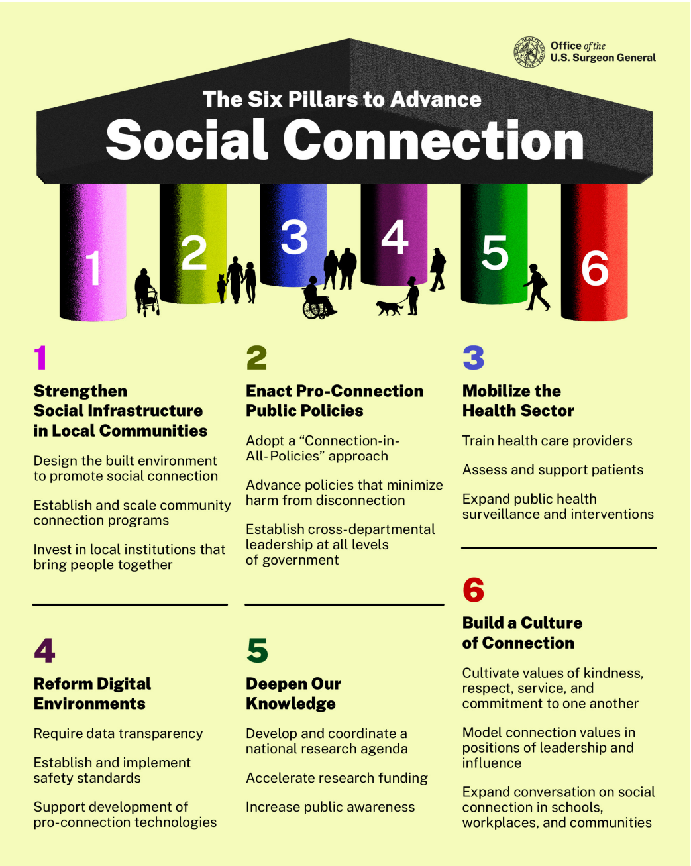
The Six Pillars to Advance Social Connection
Notes:
AD

Slide 15
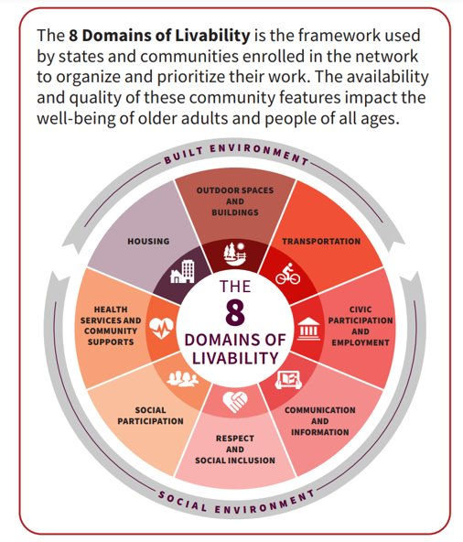
Age-Friendly Communities
Social Connectivity plays an important part in Age-Friendly Communities.
Domains include:
  Respect & Social Inclusion
  Social Participation
Other domains can support social connectivity such as:
  Outdoor spaces and Buildings
  Transportation
Notes:
AD

Slide 16
What can you do to build social connectivity?
Notes:
KW

Slide 17
Recommendations for Stakeholders
National, Territory, State, Local, and Tribal Governments
Health Systems & Workers
Public Health
Workplaces
Community-Based Organizations
Caregivers
Individuals
Notes:
This section details recommendations for how each stakeholder group can take action to advance social connection.
AD – introduce section and focus on microlevel

Slide 18
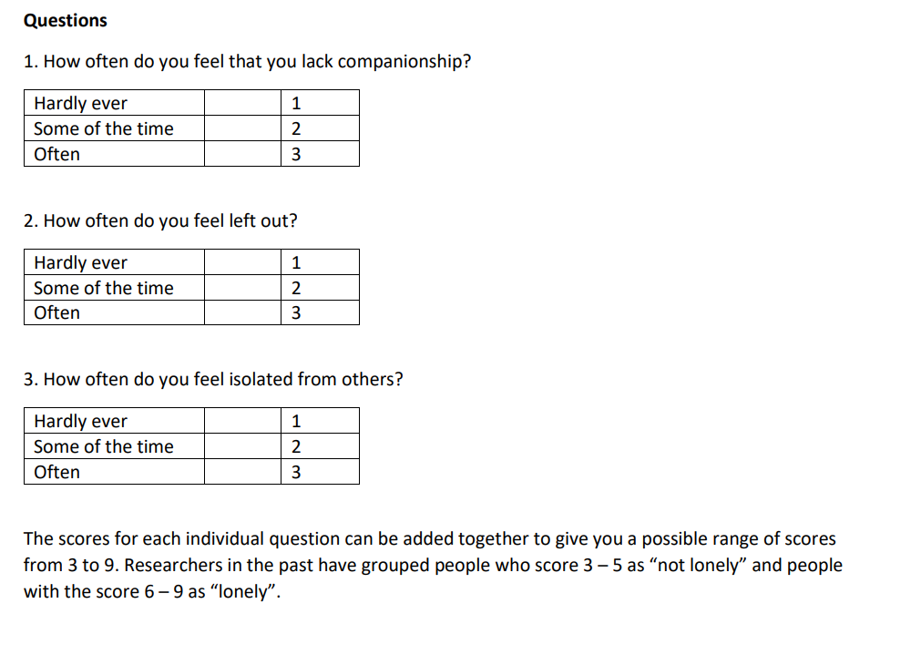
How do you know you're at risk?
UCLA 3 Questions Loneliness Scale
Notes:
KW

Slide 19
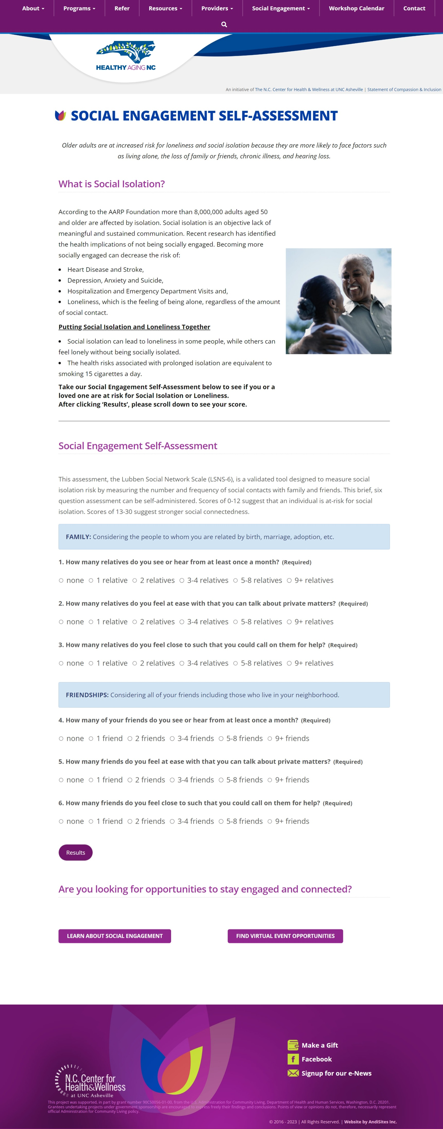
Healthy Aging NC
Social Engagement Self-Assessment
Weblink: https://healthyagingnc.com/social-engagement-landing-page/​​
Notes:
Weblink: https://healthyagingnc.com/social-engagement-landing-page/
KW

Slide 20
Healthy Aging NC
Social Engagement Self-Assessment
Weblink: https://healthyagingnc.com/social-engagement-landing-page/​​
Notes:
KW

Slide 21
Strengthening Social Connections
Invest time in nurturing your relationships​
Seek out opportunities to serve and support others​
Check out resources and programs at your local social service agencies, community and senior centers and public libraries
Reduce practices that lead to feelings of disconnection from others
Use communication technologies to help keep you engaged and connected
Consider adopting a pet
Stay physically active
Seek help during times of struggle
Notes:
AD

Slide 22
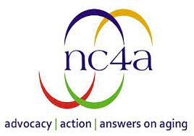
NORTH CAROLINA ASSOCIATION
OF AREA AGENCIES ON AGING (NC4A)
Website:
https://www.nc4a.org/
Contact Information:
Nc4a.org@gmail.com
NC4A’s mission is to build capacity and coordinate the activities of the 16 Area Agencies on Aging (AAAs) in North Carolina.
AAAs are charged with helping older adults and people with disabilities, along with their caregivers, live in their communities in the least restrictive environment with maximum dignity and independence for as long as possible.
Notes:
AD

Slide 23
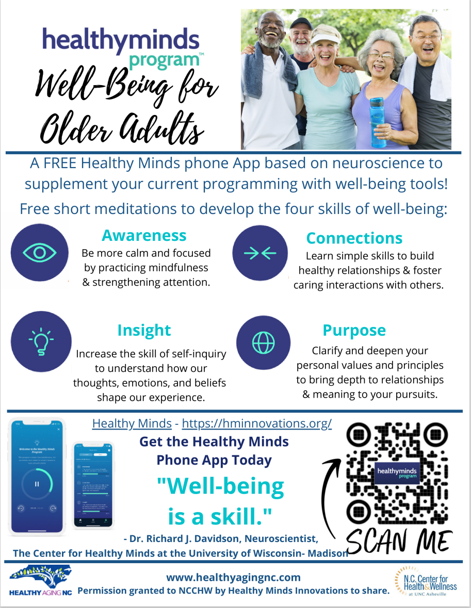
Healthy Minds
The Healthy Minds Program gives seniors free short meditations to develop four skills of well-being:
  Awareness
  Insight
  Connections
  Purpose
Website: https://hminnovations.org/
Notes:
KW

Slide 24

Social Bridging Project
The Social Bridging Project is a free service that pairs older adults who feel isolated with trained callers who can provide the following:
  A conversation and friendly check-in.
  Help using your technology devices to connect with loved ones, remotely access fitness classes or faith communities, access medical care via telehealth and more.
Referrals to resources such as transportation services, meal deliveries, no-cost wellness programs and more.
Send an email at socialbridge@unca.edu or call at (828) 250-2399
Notes:
KW

Slide 25


One Hope/NCBAM
One Hope helps those who are experiencing social isolation and loneliness.
They connect the lonely with community resources and with Christ.
Phone: (877)506-2226
onehopencbam.org
NCBAM
201-A Idol Street
Thomasville, NC 27360
A ministry of Baptist Children’s Homes of NC
Notes:
KW – Add Melanie's slides

Slide 26
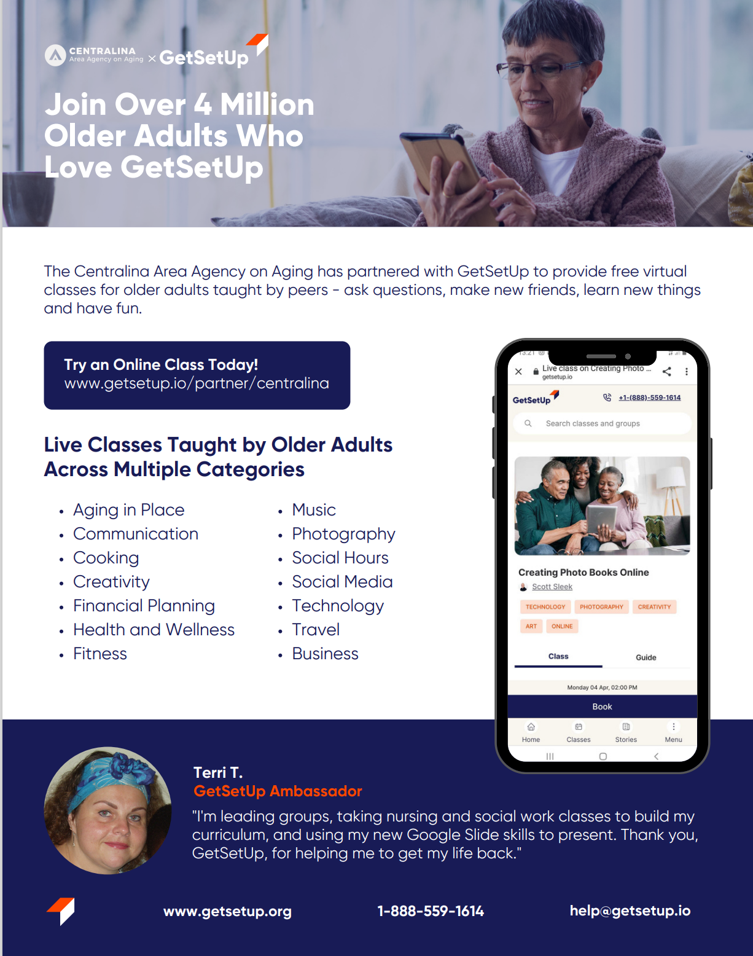
Get Set Up
Live online learning platform that provide hundreds classes 24 hours a day, 7 days a week to keep you mentally, physically and socially active.
Centralina AAA offers FREE access through our membership plan!
Website & Access Code:
https://www.getsetup.io/partner/centralina
Notes:
AD

Slide 27

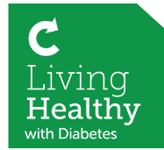
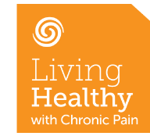
Health Promotion & Disease Prevention Programs/Workshops
 | If you have conditions such as diabetes, arthritis or high blood pressure, this workshop can help you learn how to stay healthy. | 6 Sessions 2.5 Hours per Session 12-15 Participants
 | This workshop is designed to help you better manage your diabetes and gain control of your health. | 6 Sessions 2.5 Hours per Session 12-15 Participants
 | This workshop helps people experiencing chronic pain learn how to manage their conditions. | 6 Sessions 2.5 Hours per Session 12-15 Participants
Notes:
AD

Slide 28
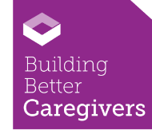

Health Promotion & Disease Prevention Programs/Workshops
 |  | 6 Sessions 2.5 Hours per Session 12-15 Participants
 | This workshop can help reduce the fear of falling and increase the activity levels of those concerned about falling. | 8 Sessions 2 Hours per Session 8-12 Participants
A workshop designed for caregivers to help you reduce stress, manage difficult behaviors, increase communication skills and locate needed local resources.
For more information and to register for a workshop please visit: https://centralinaaging.org/what-we-do-services/health-wellness/
Notes:
AD

Slide 29
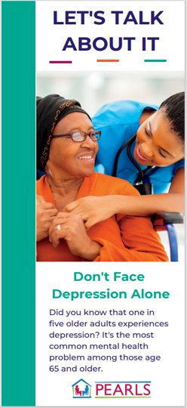
PEARLS
(Program to Encourage Active, Rewarding Lives)
A community-based program (evidence-based) designed to reduce depressive symptoms, isolation and improve quality of life in older adults.
PEARLS coaches will provide six to eight in-home or virtual sessions to help you:
Recognize the symptoms of depression
Use a seven-step approach to identify and solve problems
Plan social and physical activities, which often improve the mood of people living with depression
Who is eligible?
60 years of age and up
Adults who have minor depression or persistent depressive disorder (PDD)
  An ongoing, low-grade depression of 2 or more years.
Adults who have major depression
Adults with epilepsy and co-occurring depression
Contact Kamiya Williams for more information.
kwilliams@centralina.org / 704-688-7036
Notes:
KW

Slide 30
If you or a loved one are experiencing social isolation and/or loneliness:
Talk to your provider
Look into state, county and local resources that may be offered to you
Contact someone if you need help
Notes:
KW

Slide 31
THANK YOU
704-372-2416 | info@centralina.org | 10735 David Taylor Drive, Suite 250, Charlotte, NC 28262 | www.CentralinaAging.org
Notes:
KW

